Slide 1
Merging, Cleaning and Shaping Data

Slide 2
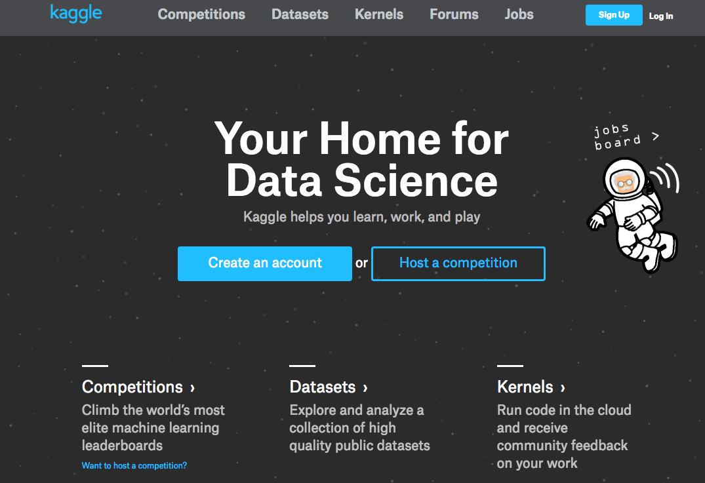
Final Project

Slide 3
Agenda
Becoming a Data Ninja
Merge & joins
Concat
Clean
Group Exercise: European Trade
Big Data Processing with Spark
Databricks CE

Slide 4
Agenda
Becoming a Data Ninja
Merge & joins
Concat
Clean
Group Exercise: European Trade
Big Data Processing with Spark
Databricks CE

Slide 5
Joining Datasets
A
B

Slide 6
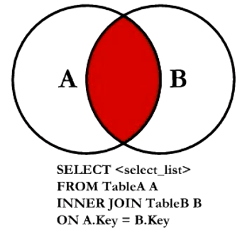
Joining Datasets : Inner Join

Slide 7
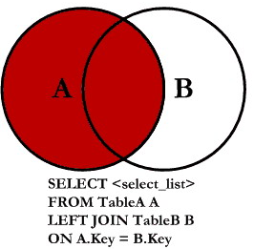
Joining Datasets : Left Outer Join

Slide 8
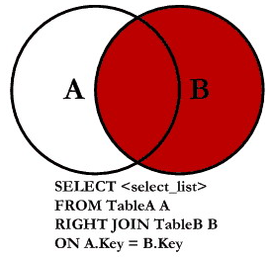
Joining Datasets : Right Outer Join

Slide 9
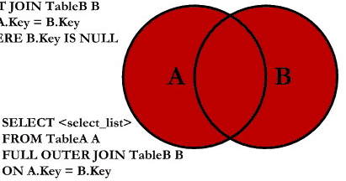
Joining Datasets : Full Outer Join
SELECT <select_list>
FROM TableA A
FULL OUTER JOIN TableB B
ON A.Key = B.Key

Slide 10
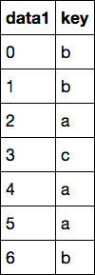
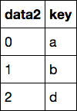
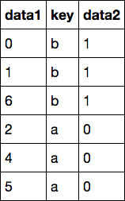
Merging (inner join)
merge
→

Slide 11
Merging (inner join)
inner join
→

Slide 12
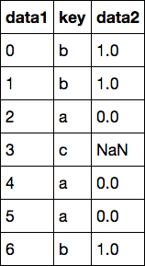
Merging (left outer join)
outer join
→

Slide 13
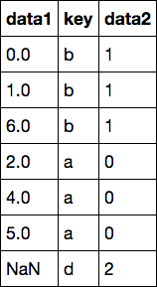
Merging (right outer join)
outer join
→

Slide 14
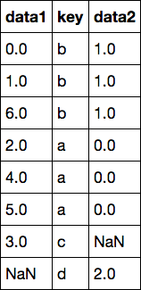
Merging (full outer join)
outer join
→

Slide 15
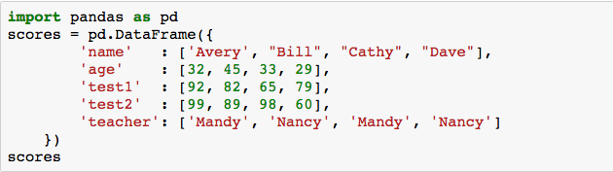
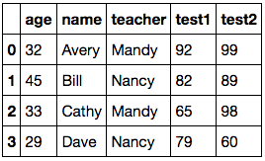
GroupBy : setup

Slide 16
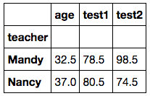
GroupBy : by teacher

Slide 17
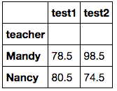
GroupBy : by teacher

Slide 18
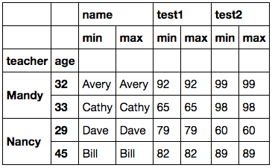
GroupBy : specific aggregations

Slide 19
Open notebook: “lecture06.data.shaping”

Slide 20
Agenda
Becoming a Data Ninja
Merge & joins
Concat
Clean
Group Exercise: European Trade
Big Data Processing with Spark
Databricks CE

Slide 21
Group Exercise: European Trade

Slide 22
European Union circa 2016

Slide 23
Extra-EU Trade Data for 2010, 2012, 2014
http://ec.europa.eu/eurostat/web/products-datasets/-/ext_lt_invcur

Slide 24
“Extra-EU trade”
“Extra-EU trade” statistics cover the trading of goods between Member States and a non-member countries.

Slide 25
SITC
SITC : Standard International Trade Classification
SITC0-4A

Slide 26
Extra-EU Trade Data for 2010, 2012, 2014
partner,currency,stk_flow,sitc06,geo\time 2014 2012 2010
EXT_EU,EUR,EXP,SITC0-4A,AT 61.9 65.6 67
EXT_EU,EUR,EXP,SITC0-4A,BE 53.8 85.8 92.4
EXT_EU,EUR,EXP,SITC0-4A,BG 57 46.2 54.1
EXT_EU,EUR,EXP,SITC0-4A,CY 79.1 60.7 61.4
EXT_EU,EUR,EXP,SITC0-4A,CZ 58.3 66.7 59.1
EXT_EU,EUR,EXP,SITC0-4A,DE 62.5 61.5 65.9
EXT_EU,EUR,EXP,SITC0-4A,DK 12.8 14 12.2
EXT_EU,EUR,EXP,SITC0-4A,EA 60.7 65.4 64.1
EXT_EU,EUR,EXP,SITC0-4A,EE 67.9 62.8 51.8
EXT_EU,EUR,EXP,SITC0-4A,EL 60.3 58.4 59
EXT_EU,EUR,EXP,SITC0-4A,ES 61.8 63.7 75.6
EXT_EU,EUR,EXP,SITC0-4A,EU 50.1 53.5 53.2
EXT_EU,EUR,EXP,SITC0-4A,FI 42.4 40.7 47.7
EXT_EU,EUR,EXP,SITC0-4A,FR 63.8 62.3 58.4
EXT_EU,EUR,EXP,SITC0-4A,HR 77.3 : :
EXT_EU,EUR,EXP,SITC0-4A,HU 45.4 45.5 67.8
...

Slide 27
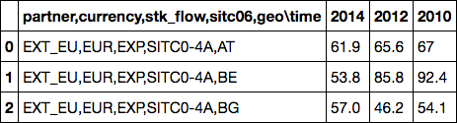
Read in by chunk of 100 rows
df = pd.DataFrame()
for chunk in pd.read_csv('data/ext_lt_invcur.tsv', sep='\t', chunksize=100):
df = pd.concat([df, chunk])

Slide 28
Transforming column 1 : step 1 (splitting)
df = pd.DataFrame()
for chunk in pd.read_csv('data/ext_lt_invcur.tsv', sep='\t', chunksize=100):
data_rows = [row for row in chunk.ix[:,0].str.split(',')]
data_cols = chunk.columns[0].split(',')
print(data_rows[:2], data_cols)
break;
([['EXT_EU', 'EUR', 'EXP', 'SITC0-4A', 'AT'], ['EXT_EU', 'EUR', 'EXP', 'SITC0-4A', 'BE']], ['partner', 'currency', 'stk_flow', 'sitc06', 'geo\\time'])

Slide 29
Transforming column 1 : step 2 (fixing colname)
df = pd.DataFrame()
for chunk in pd.read_csv('data/ext_lt_invcur.tsv', sep='\t', chunksize=100):
data_rows = [row for row in chunk.ix[:,0].str.split(',')]
data_cols = [col.split('\\')[0] for col in chunk.columns[0].split(',')]
print(data_rows[:2], data_cols)
break;
([['EXT_EU', 'EUR', 'EXP', 'SITC0-4A', 'AT'], ['EXT_EU', 'EUR', 'EXP', 'SITC0-4A', 'BE']], ['partner', 'currency', 'stk_flow', 'sitc06', 'geo'])

Slide 30
Transforming column 1 : step 3 (merge)
df = pd.DataFrame()
for chunk in pd.read_csv('data/ext_lt_invcur.tsv', sep='\t', chunksize=100):
data_rows = [row for row in chunk.ix[:,0].str.split(',')]
data_cols = [col.split('\\')[0] for col in chunk.columns[0].split(',')]
clean_df = pd.DataFrame(data_rows, columns=data_cols)
# now we can concat by "column" which means axis=1
new_df = pd.concat([clean_df, chunk], axis=1)
print(new_df)
break;
partner currency stk_flow sitc06 geo \
0 EXT_EU EUR EXP SITC0-4A AT
1 EXT_EU EUR EXP SITC0-4A BE
2 EXT_EU EUR EXP SITC0-4A BG
3 EXT_EU EUR EXP SITC0-4A CY
4 EXT_EU EUR EXP SITC0-4A CZ

Slide 31
Transforming column 1 : step 4 (clean)
df = pd.DataFrame()
for chunk in pd.read_csv('data/ext_lt_invcur.tsv', sep='\t', chunksize=100):
data_rows = [row for row in chunk.ix[:,0].str.split(',')]
data_cols = [col.split('\\')[0] for col in chunk.columns[0].split(',')]
clean_df = pd.DataFrame(data_rows, columns=data_cols)
# now we can concat by "column" which means axis=1
new_df = pd.concat([clean_df, chunk.drop(chunk.columns[0], axis=1)],
axis=1)
print(new_df)
break;
partner currency stk_flow sitc06 geo
0 EXT_EU EUR EXP SITC0-4A AT
1 EXT_EU EUR EXP SITC0-4A BE
2 EXT_EU EUR EXP SITC0-4A BG
3 EXT_EU EUR EXP SITC0-4A CY
4 EXT_EU EUR EXP SITC0-4A CZ

Slide 32
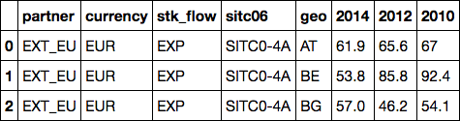
Transforming column 1 : step 5 (finalize)
df = pd.DataFrame()
for chunk in pd.read_csv('data/ext_lt_invcur.tsv', sep='\t', chunksize=100):
data_rows = [row for row in chunk.ix[:,0].str.split(',')]
data_cols = [col.split('\\')[0] for col in chunk.columns[0].split(',')]
clean_df = pd.DataFrame(data_rows, columns=data_cols)
# now we can concat by "column" which means axis=1
new_df = pd.concat([clean_df, chunk.drop(chunk.columns[0], axis=1)],
axis=1)
df = pd.concat([df, new_df])

Slide 33
Data Exploration
df.shape()
(1320, 8)

Slide 34
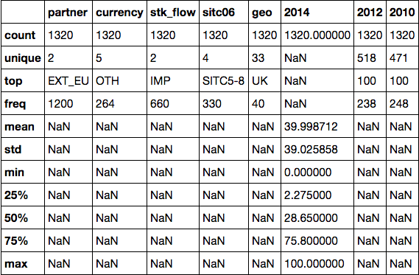
Data Exploration
df.describe(include=‘all’)

Slide 35
Group Exercise
Find the “mean” 2014 EU export % to Extra-EU states with:
sitc06==“SITC33” #petroleum products
currency==“EUR” # euro currency
Stk_flow==“EXP” # export only

Slide 36
Agenda
Becoming a Data Ninja
Merge & joins
Concat
Clean
Group Exercise: European Trade
Big Data Processing with Spark
Databricks CE

Slide 37
Big Data Processing with

Slide 38
What is Apache Spark?
A distributed computing framework
for scalable, efficient analysis of big data.

Slide 39
What is Big Data?
Volume
Variety
Velocity
^{Big Data}
“Big Data” Tech Stack

Slide 44
^{Cities}
^{Infrastructure}
^{Industrial}
^{Family Assets}
^{Smart Appliances}
^{Personal Devices}

Slide 45
The Big Data Problem
1 machine cannot store nor process all the data
Idea: distribute data in ”clusters of machines” for “distributed computing”

Slide 46
Distributed Computing : Word Count
“I am Sam; I am Sam.”

Slide 47
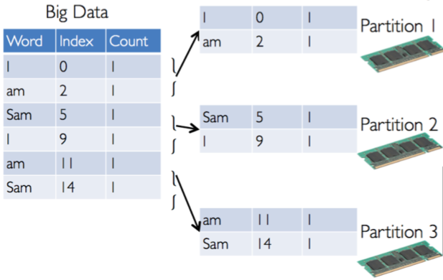
Distributed Computing : Word Count
DataFrame

Slide 48
Apache Spark Components
Spark SQL
Spark Streaming
MLlib &
ML
GraphFrame (or GraphX)
Apache Spark Core

Slide 49
Python Spark
We use the Python programming interface to Spark (pySpark)

Slide 50
Spark Driver & Workers
Driver Program
SparkContext
Cluster Manager
Local
Threads
Worker
(executor)
Worker
(executor)
Storage

Slide 51
SparkContext
When a Spark program starts, it creates a SparkContext object
SparkContext tells Spark how and where to access a cluster
pySpark shell, Databricks CE automatically create SparkContext
iPython and user created programs must create a new SparkContext
The program next creates a sqlContext object
Use sqlContext to create DataFrames

Slide 52
Spark DataFrame
Not the same as a pandas DataFrame!
Spark DataFrame: the primary data abstraction in Spark
Immutable once constructed
Track lineage information to efficiently recompute lost data
Enable operations on collection of elements in parallel
Create a DataFrame by:
by parallelizing existing Python collections (lists)
by transforming an existing Spark or pandas DFs
from files in HDFS or any other storage system

Slide 53
Spark DataFrame
Each row of a DataFrame is a Row object
The fields in a Row can be accessed like attributes >>> row = Row(name="Alice", age=11) >>> row Row(age=11, name='Alice') >>> row['name'], row['age'] ('Alice', 11) >>> row.name, row.age ('Alice', 11)

Slide 54
DataFrame: 2 types of ops
Transformations
Transformations are lazy (not computed immediately)
Transformed DF is executed when action runs on it
Persist (cache) DFs in memory or disk
Actions : collect, show, reduce, …
DataFrame
Filtered DataFrame
Filtered DataFrame
DataFrame
Filtered DataFrame
Filtered DataFrame
<list>
DataFrame
Filtered DataFrame
Transformed DataFrame
results
createDF
filter
transform
show

Slide 55
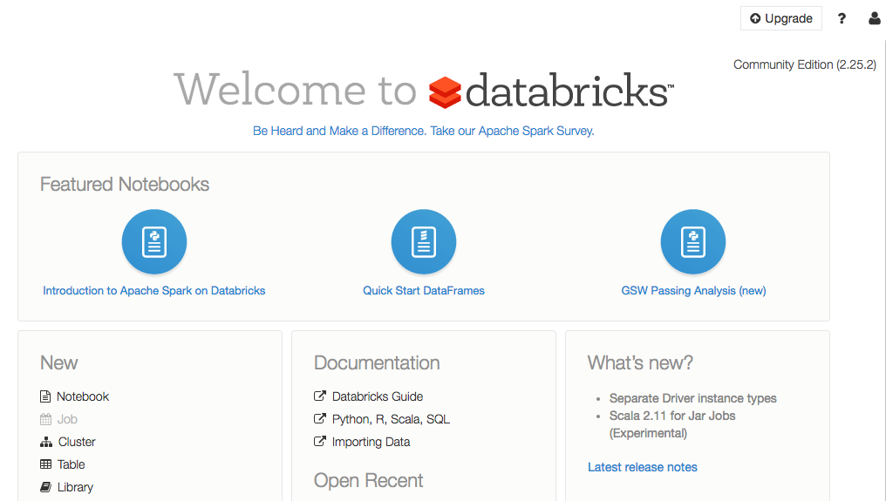
Spark / Databricks Community Edition

Slide 56
https://databricks.com/ce

Slide 57
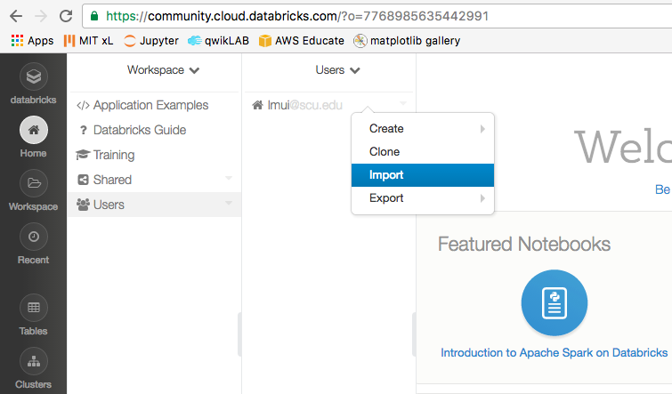
Upload “lecture06.intro.spark.dbc”

Slide 58
Next week
Complete work of Shakespeare
NASA Weblog analysis

